Slide 1
W200 Python Project 2 nypd_7_major_felony_incidents
Haihui Cao
Kenneth Chen
Benjamin Silk
03-31-2018

Slide 2
https://data.cityofnewyork.us/Social-Services/nypd-7-major-felony-incidents/k384-xu3q/data
52 features
9 million cases

Slide 3
Kenneth’s approach
Cases Engineering
9 million cases (original data 4.7GB as at 03-27-2018)
8 million cases (after removing NaN in features [1] and [2], start date and closed date)
8 million cases (after removing NaN in Latitude and Longitude features)
From feature [1] and [2], calculate the datetime, extract the total days taken,
some cases are negative days which do not make sense, remove those cases
4 million cases (after removing negative days)
All columns
0 Unique Key
1 Created Date
2 Closed Date
3 Agency
4 Agency Name
5 Complaint Type
6 Descriptor
7 Location Type
8 Incident Zip
9 Incident Address
10 Street Name
11 Cross Street 1
12 Cross Street 2
13 Intersection Street 1
14 Intersection Street 2
15 Address Type
16 City
17 Status
18 Community Board
19 Borough
20 X Coordinate (State Plane)
21 Y Coordinate (State Plane)
22 Park Borough
23 Latitude
24 Longitude
25 Location
Features Engineering
52 features
26 features (after removing empty columns, unimportant features)
26 features (reset the columns index to [0:25])

Slide 4
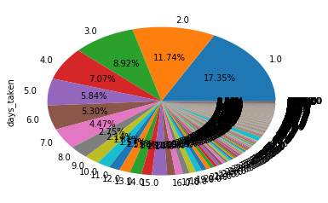
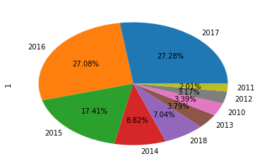
days taken Vs the number of cases
1.0 698600
2.0 472468
3.0 359243
4.0 284605
5.0 235271
6.0 213304
7.0 180069
8.0 110899
9.0 86174
10.0 12638
…
10988.0 1
11012.0 1
30739.0 1
67258.0 1
During the span of 8 years (2010-2018), 17% of cases took 1 day followed by 12% of cases that took 2 days to close.
Number of Cases in each year
2017 1098075
2016 1090294
2015 700762
2014 354873
2018 283482
2013 152612
2010 136477
2012 127772
2011 81107
There are more cases reported to NYPD in recent years.

Slide 5
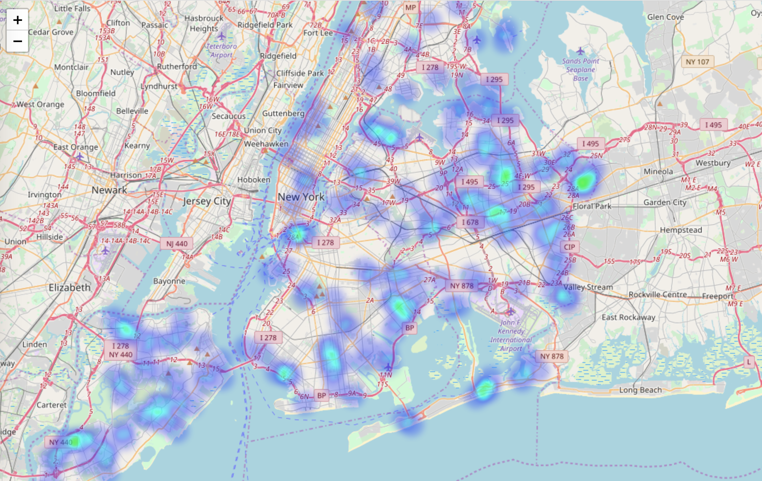
Heatmap showing NYPD cases that took more than 100 days

Slide 6
Haihui’s approach

Slide 7
Benjamin’s approach

